Slide 1
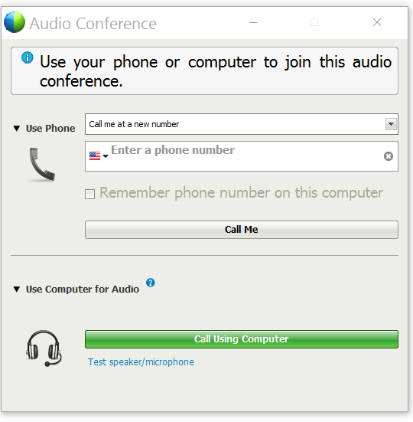
Welcome! Our Webinar Will Start Shortly. Please take a minute to go over some tips.
For Audio, call in using your phone
Viewing Jim Smith
Or the computer (headset required)
During the webinar, you can hover your mouse over the top-middle of your webinar screen to access the toolbar.
From here you can:
Change your audio settings
Mute/unmute yourself
View the participants and chat windows
Speaking: Linda Bryson
Jim Smith (Host)
Linda Bryson (me)
If you accidently minimize the webinar screen, look for the green and blue WebEx ball
Use the chat box to interact with facilitator & participants

Slide 2
PREPAID MAINTENANCE For Volkswagen Models
Kia Protect Prepaid Maintenance
Understanding and Selling the Product
Understanding and Selling the Product
Notes:
For VW

Slide 3
Objectives
Introduce the features of SecureDrive Prepaid Maintenance
Describe vehicle eligibility and Prepaid Maintenance terms and conditions
Describe the benefits for the customer and dealer
Explain the process for selling a Prepaid Maintenance contract using the HUB
Notes:
Upon completion of this course, you will be able to…

Slide 4
What is SecureDrive Prepaid Maintenance?
Coverage available on any new Volkswagen vehicle that is either financed, leased, or cash-purchased.
A service contract designed to provide customers coverage for service needs of their vehicles such as oil and filter changes, tire rotation and more.
Dealers can offer protection that suits the intended ownership period of their customers while keeping with the OEM recommended intervals for normal or severe usage conditions.
Notes:
Coverage is available only for new VW vehicles that are either financed, leased or cash-purchased.
<click> SecureDrive Prepaid Maintenance is a service contract designed to allow customers to lock in the cost of service needs for their vehicles such as oil and filter changes, tire rotation and more. The product is designed to lock in today’s price for vehicle maintenance and help the customer reduce out of pocket maintenance costs.
<click>Dealers can offer protection that suits the intended ownership period of their customers while keeping with the OEM recommended intervals for both normal and severe usage conditions.
Severe use – any use of your vehicle outside of normal operating conditions, including:
For commercial purposes
In extreme temperatures and/or climates
For emergency use
Non-standard recreational uses
Or in any other conditions for which your vehicle requires more frequent services than the recommended service intervals
As per the VW recommendations, the intervals are set at 12 months. If an oil change is needed every 6 months instead, the dealers can add more oil changes at the dealership level, or if a Basic plan is sold, the customer could get their intervals done earlier.

Slide 5
Why is there a need for Prepaid Maintenance?
Why is there a need for Prepaid Maintenance?
Protects the customers against inflation by locking in the price of maintenance at today’s price.
Provides convenience to the customers who like to plan ahead.
Offers up to 25% discounts instead of paying for the services out of pocket at each visit.
Increases potentially the resell and trade in value of the Volkswagen vehicle.
Notes:
<click> Prepaid Maintenance protects your customer against inflation by locking in the price of maintenance at today’s price
<click> This program allows the customer to plan ahead by pre-paying and avoiding out-of-pocket expenses.
<click> It also offers up to 25% discounts instead of paying for the services out of pocket at each visit
As you know most of your customers typically aren’t thrilled with the trade-in value of their car
<click> When introducing Prepaid Maintenance, to finance and cash customers, it’s important to fast forward to a later time when the customer will be trading or selling their vehicle. Remind them that Prepaid Maintenance will help to keep the car well-maintained while driving it and, as a result of that, the maximum value of the car will potentially be preserved or increased for trade-in or resell later on!

Slide 6
How can Prepaid Maintenance benefit your dealership?
Helps to increase customer retention by bringing back the customer to the Selling Dealership for maintenance.
(the program can be serviced only at the selling dealership!)
Opportunity to generate substantial service department revenue that could go outside the dealership.
Allows upsell opportunities from the Service Department if additional items are needed that would not be covered by the purchased plan.
Notes:
Main feature!! : Prepaid Maintenance helps to increase customer retention and has your customer coming back to the dealership for regular touch points. Here are some statistics about retention:
Statistics show that 36% of car owners go to a dealership for regular maintenance
Only 22% go for oil changes
91% of car owners who get their oil changes at dealership also get their service done there
<click> This program is an opportunity to generate substantial service department revenue that could otherwise go outside the dealership to a 3rd party like Mr. Lube or Canadian Tire
<click> Another benefit for the dealership is that since Prepaid Maintenance only covers essential service needs, it provides an opportunity for the Service Department to sell the customer additional services required for their vehicle. A suggestion is to offer services such as brake inspections, brake flushes, coolant services and fuel additive.

Slide 7
Prepaid Maintenance Eligibility
Prepaid Maintenance Eligibility
Must be a Volkswagen model.
Must be a new vehicle within 12 months and 15,000 kilometers
First service must not have been performed yet
There are no exclusions on commercial vehicles
The e-Golf and the new Arteon are not currently eligible for Prepaid Maintenance
Notes:
Prepaid Maintenance is available for volkswagen models only.
<click> To qualify for new vehicle rates, a vehicle must be within 12 months and 15 000 kilometers to qualify. It can be sold when the customer goes to the dealership for their first oil change. The Service Department can remind customers at this point that they are still eligible to purchase Prepaid Maintenance and use it for their first service.
Used vehicles do not qualify. Certified pre-owned do not qualify at the moment but we are currently working to have it included.
<click> There are no exclusions for commercial or light commercial vehicles and both qualify for Prepaid Maintenance coverage
<click> There are no exclusions for on Hybrid or Plug-in Hybrid models
<click> The only 2 volkswagen models not currently eligible for Prepaid Maintenance coverage are the e-Golf and the new Arteon

Slide 8
Prepaid Maintenance e Options
Prepaid Maintenance Plan Options – Basic Plan
Covers the essential maintenance needs of Volkswagen vehicles
Maintenance/Common Wear Items | 1 | 2 | 3 | 4 | 5 | 6 | 7 | 8
Replace Engine Oil | ● | ● | ● | ● | ● | ● | ● | ●
Replace Engine Oil Filter | ● | ● | ● | ● | ● | ● | ● | ●
Replace Engine Oil Drain Plug Gasket | ● | ● | ● | ● | ● | ● | ● | ●
Multi-point Inspection | ● | ● | ● | ● | ● | ● | ● | ●
Shop Supplies | ● | ● | ● | ● | ● | ● | ● | ●
Notes:
Here are the different coverage options for Prepaid Maintenance. Let’s start with the Basic Plan. There are 8 different intervals offered. Customers can purchase intervals of 2 to 8.
As mentioned before, these intervals have been setup to be used once per year but the customer could have them done earlier as needed (for oil change…)

Slide 9
Prepaid Maintenance Coverage Options
Prepaid Maintenance Plan Options – Plus Plan
Covers the maintenance needs required for the manufacturer warranty
In addition to the items covered by the Basic Plan, the following items are covered under the Plus Plan:
Maintenance/Common Wear Items | 1 | 2 | 3 | 4 | 5 | 6 | 7 | 8
Rotate Tires | ● | ● | ● | ● | ● | ● | ● | ●
Replace Pollen Filter |  | ● |  | ● |  | ● |  | ●
Replace Engine Air Filter |  |  |  |  |  | ●
Replace Spark Plugs |  |  |  | ● |  |  |  | ●
Notes:
This now is the Plus plan, to cover the maintenance needs required for the manufacturer warranty.
The following items are covered under the Plus Plan in addition to the items covered by the Basic Plan

Slide 10
Prepaid Maintenance e Options
Prepaid Maintenance Plan Options – Optional Items
Covers maintenance needs specific to some models and trims
In addition to the items covered by the Plus Plan, the following items are optional for specific models/trims only:
Maintenance/Common Wear Items | 1 | 2 | 3 | 4 | 5 | 6 | 7 | 8
Direct-Shift Gearbox (DSG) transmission service (Refer to the Owner's Manual of your vehicle to determine if required) |  |  |  | ● |  |  |  | ●
Haldex oil service (4Motion models/trims only) |  |  |  | ● |  |  |  | ●
Automatic Transmission Fluid (ATF) service (Atlas and Tiguan models only) |  |  |  |  |  |  |  | ●
Notes:
Here are the different optional items that can be covered for specific models

Slide 11
Pricing and Markup – Basic Plan – Class 1
Class 1: Beetle, Beetle Convertible, Golf, Golf GTI, Golf R, Golf SportWagen, Golf Alltrack, Jetta
Maintenance Interval | Dealer Cost | Retail PPM Price | Dealer Markup
2 | $226 | $326 | $100
3 | $330 | $430
4 | $437 | $587 | $150
5 | $537 | $687
6 | $637 | $837 | $200
7 | $731 | $931
8 | $830 | $1,030
Notes:
Now let’s take a look at the pricing and markup for each of the classes and Plans, starting with the Basic Plan for Class 1 vehicles.
You can find this information on quick quotes. When you hover the mouse on the price you will see the markup. Just be careful of you are sharing your screen with your customer, they will also be able to see this.

Slide 12
Pricing and Markup – Plus Plan – Class 1
Class 1: Beetle, Beetle Convertible, Golf, Golf GTI, Golf R, Golf SportWagen, Golf Alltrack, Jetta
Maintenance Interval | Dealer Cost | Retail PPM Price | Dealer Markup
2 | $352 | $552 | $200
3 | $488 | $688
4 | $824 | $1,124 | $300
5 | $952 | $1,252
6 | $1,168 | $1,568 | $400
7 | $1,290 | $1,690
8 | $1,597 | $1,997
Notes:
Plus Plan for Class 1 vehicles

Slide 13
Pricing and Markup – Additional Option – Class 1
Surcharge for Class 1: Beetle, Beetle Convertible, Golf, Golf GTI, Golf R, Golf SportWagen, Golf Alltrack, Jetta
Option | 2 | 3 | 4 | 5 | 6 | 7 | 8
DSG Transmission Service | n/a | n/a | $235 | $235 | $235 | $235 | $450
Haldex Oil Service | n/a | n/a | $98 | $98 | $98 | $98 | $187
Notes:
Additional option for Class 1 vehicles: CR-V and HR-V

Slide 14
Pricing and Markup – Basic Plan – Class 2
Class 2: Passat
Maintenance Interval | Dealer Cost | Retail PPM Price | Dealer Markup
2 | $229 | $329 | $100
3 | $335 | $435
4 | $443 | $593 | $150
5 | $543 | $693
6 | $645 | $845 | $200
7 | $741 | $941
8 | $841 | $1,041
Notes:
Basic Plan for Class 2 vehicles

Slide 15
Pricing and Markup – Plus Plan – Class 2
Class 2: Passat
Maintenance Interval | Dealer Cost | Retail PPM Price | Dealer Markup
2 | $355 | $555 | $200
3 | $492 | $692
4 | $868 | $1,168 | $300
5 | $997 | $1,297
6 | $1,212 | $1,612 | $400
7 | $1,335 | $1,735
8 | $1,679 | $2,079
Notes:
Plus Plan for Class 2 vehicles

Slide 16
Pricing and Markup – Additional Option – Class 2
Surcharge for Class 2: Passat
Option | 2 | 3 | 4 | 5 | 6 | 7 | 8
DSG Transmission Service | n/a | n/a | $274 | $274 | $274 | $274 | $524
Notes:
Additional options for Class 2 vehicles

Slide 17
Pricing and Markup – Basic Plan – Class 3
Class 3: Tiguan
Maintenance Interval | Dealer Cost | Retail PPM Price | Dealer Markup
2 | $253 | $353 | $100
3 | $371 | $471
4 | $491 | $641 | $150
5 | $602 | $752
6 | $715 | $915 | $200
7 | $820 | $1,020
8 | $931 | $1,131

Slide 18
Pricing and Markup – Plus Plan – Class 3
Class 3: Tiguan
Maintenance Interval | Dealer Cost | Retail PPM Price | Dealer Markup
2 | $388 | $588 | $200
3 | $537 | $737
4 | $888 | $1,188 | $300
5 | $1,028 | $1,328
6 | $1,263 | $1,663 | $400
7 | $1,396 | $1,796
8 | $1,718 | $2,118

Slide 19
Pricing and Markup – Additional Option – Class 3
Surcharge for Class 3: Tiguan
Option | 2 | 3 | 4 | 5 | 6 | 7 | 8
Haldex Oil Service | n/a | n/a | $98 | $98 | $98 | $98 | $187
ATF Service | n/a | n/a | n/a | n/a | n/a | n/a | $339

Slide 20
Pricing and Markup – Basic Plan – Class 4
Class 4: Atlas
Maintenance Interval | Dealer Cost | Retail PPM Price | Dealer Markup
2 | $234 | $334 | $100
3 | $342 | $442
4 | $453 | $603 | $150
5 | $555 | $705
6 | $659 | $859 | $200
7 | $757 | $957
8 | $859 | $1,059

Slide 21
Pricing and Markup – Plus Plan – Class 4
Class 4: Atlas
Maintenance Interval | Dealer Cost | Retail PPM Price | Dealer Markup
2 | $360 | $560 | $200
3 | $499 | $699
4 | $876 | $1,176 | $300
5 | $1,008 | $1,308
6 | $1,228 | $1,628 | $400
7 | $1,353 | $1,753
8 | $1,698 | $2,098

Slide 22
Pricing and Markup – Additional Option – Class 4
Surcharge for Class 4: Atlas
Option | 2 | 3 | 4 | 5 | 6 | 7 | 8
Haldex Oil Service | n/a | n/a | $98 | $98 | $98 | $98 | $187
ATF Service | n/a | n/a | n/a | n/a | n/a | n/a | $397

Slide 23
How to Submit a Prepaid Maintenance Claim
The submission process is the same as that of SecureDrive MBP or Appearance Protection.
You can submit a claim by calling the administrator at 1-866-287-6200
LGM currently developing to allow Service Department to submit claims directly through HUB
The customer’s first service can be scheduled the day they purchase the vehicle
Service Department can contact LGM and have the services pre-authorized before the customers comes in
Notes:
Now let’s look at how to submit a prepaid maintenance claim.
The submission process is pretty similar to that of MBP. You can submit a claim by calling the administrator toll-free at 1-866-287-6200. We are currently working to allow the service department to submit the claims directly through HUB.
It’s just that easy - the customer can purchase the car, buy the product and can schedule their first service visit at the service desk all in the same day.
To speed things along, the service can call in the claim at LGM and have the services pre-authorized before the customer even comes in.

Slide 24
Parts and Labour Reimbursement – Class 1
Class 1: Beetle, Beetle Convertible, Golf, Golf GTI, Golf R, Golf SportWagen, Golf Alltrack, Jetta
 | Reimbursement per interval
Maintenance Interval | Basic Plan | Plus Plan | Optional: DSG Transmission Service | Optional: Haldex Oil Service
1 | $105 | $141
2 | $105 | $205
3 | $105 | $141
4 | $105 | $365 | $268 | $111
5 | $105 | $141
6 | $105 | $246
7 | $105 | $141
8 | $105 | $365 | $268 | $111
Notes:
Here is some information regarding the service team and parts and labour pricing:
** Emphasize service only done at selling dlr!!
(Click) The specific amounts are shown on screen and apply for all dealers nationwide.
(click) Any additional items to be covered can be sold at dealer rates and billed on a separate order

Slide 25
Parts and Labour Reimbursement – Class 2
Class 2: Passat
 | Reimbursement per interval
Maintenance Interval | Basic Plan | Plus Plan | Optional: DSG Transmission Service
1 | $106 | $142
2 | $106 | $207
3 | $106 | $142
4 | $106 | $410 | $312
5 | $106 | $142
6 | $106 | $245
7 | $106 | $142
8 | $106 | $410 | $312
Notes:
Here is some information regarding the service team and parts and labour pricing:
** Emphasize service only done at selling dlr!!
(Click) The specific amounts are shown on screen and apply for all dealers nationwide.
(click) Any additional items to be covered can be sold at dealer rates and billed on a separate order

Slide 26
Parts and Labour Reimbursement – Class 3
Class 3: Tiguan
 | Reimbursement per interval
Maintenance Interval | Basic Plan | Plus Plan | Optional: Haldex Oil Service | Optional: ATF Service
1 | $119 | $155
2 | $119 | $229
3 | $119 | $155
4 | $119 | $383 | $111
5 | $119 | $155
6 | $119 | $269
7 | $119 | $155
8 | $119 | $383 | $111 | $423
Notes:
Here is some information regarding the service team and parts and labour pricing:
** Emphasize service only done at selling dlr!!
(Click) The specific amounts are shown on screen and apply for all dealers nationwide.
(click) Any additional items to be covered can be sold at dealer rates and billed on a separate order

Slide 27
Parts and Labour Reimbursement – Class 4
Class 4: Atlas
 | Reimbursement per interval
Maintenance Interval | Basic Plan | Plus Plan | Optional: Haldex Oil Service | Optional: ATF Service
1 | $109 | $145
2 | $109 | $209
3 | $109 | $145
4 | $109 | $412 | $111
5 | $109 | $145
6 | $109 | $252
7 | $109 | $145
8 | $109 | $412 | $111 | $495
Notes:
Here is some information regarding the service team and parts and labour pricing:
** Emphasize service only done at selling dlr!!
(Click) The specific amounts are shown on screen and apply for all dealers nationwide.
(click) Any additional items to be covered can be sold at dealer rates and billed on a separate order

Slide 28
Terms & Provisions
Terms & Provisions
New Vehicle Terms
24 – 96 months Terms
6 months added for plan expiration
Transferability
$100 Transfer fee applies
(except where prohibited by law)
Cancellation Provision
Prepaid Maintenance is fully refundable within 30 days. Non-cancellable by customer after 30 days. (Dealer may override if participating in the refund)
Should Lienholder request cancellation due to total loss or repossession after 90 days from the date of purchase the dealer is not required to participate.
Notes:
The expiration is calculated at 12 months per interval, (with an additional 6 months added)
Based on the customer’s driving habits, you can provide them longer terms and more service intervals.
Prepaid Maintenance is fully transferable to the next private owner for $100 transfer fee (not applicable in Quebec).
And the policy is fully refundable if cancelled by the customer within 30 days. Following 30 days, the policy remains with the vehicle unless a specific situation arises and your dealership will participate in the refund. In those circumstances, just call customer service, they’ll walk you through the process.

Slide 29
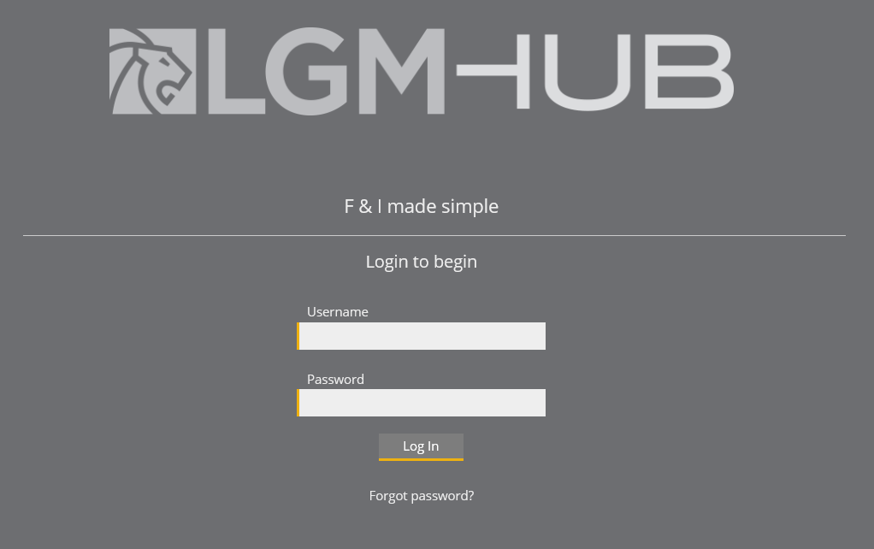
LGM HUB
LGM HUB
Products are available as an online registration only - there is no need to complete pre-printed forms.
Every policy must be registered through the HUB to ensure coverage is effective for your customer immediately.
Simply log on to get started.
Notes:
This product is available as an online registration. Instead of completing pre-printed forms, you and your staff can sell products using the HUB.
Every policy must be registered through the HUB to ensure that coverage is effective for your customers immediately. To register the sale of a product, simply log in to get started.

Slide 30
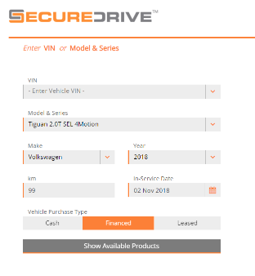
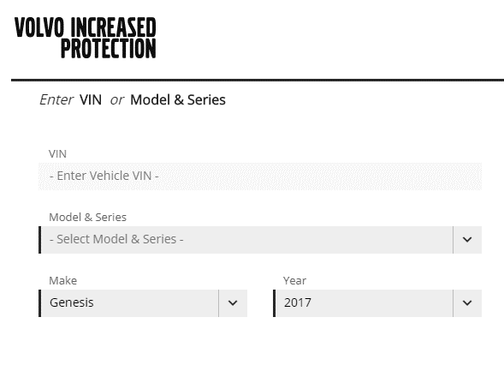
Vehicle Information
LGM HUB – Vehicle Information
Quick Quote screen:
Enter either the VIN or the Year, Make, and Model of the vehicle. Once you have entered this in, the additional vehicle details will populate.
2. Next, enter Kilometres, In-Service Date, and Vehicle Purchase Type.
Notes:
The first step in registering a sale with the HUB is to enter the vehicle’s information using the “Quick Quote” feature. To begin the process, please complete the following steps:
<click> Enter either the VIN or the Year, Make, and Model of the vehicle. Once this is complete, the field that reads “Additional Vehicle Details” will populate with the vehicle’s information.
<click> Enter the kilometres, in-service date, and vehicle purchase type (cash, finance, or lease). When this is complete, you can click “Show Available Products”

Slide 31
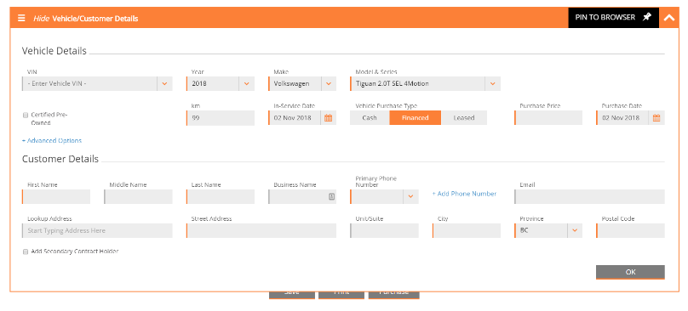
LGM HUB – Customer Information
When vehicle information is entered, you can then enter the customer information. This can be completed from expanding the customer details field under the vehicle information.
Enter required information such as Name, Primary Phone Number, Street Address, City, Province, and Postal Code.
Notes:
Once you have entered the appropriate vehicle information, you can now enter your customers’ information. The section “Customer Details” can be found on the left side of your screen, under “Vehicle Details”
Required fields are indicated on screen. These fields include name, primary phone number, street address, city, province, and postal code.

Slide 32
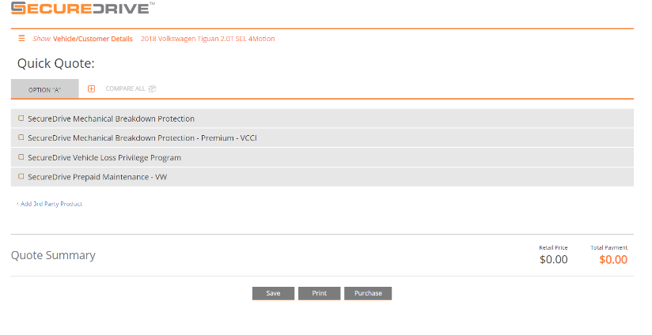
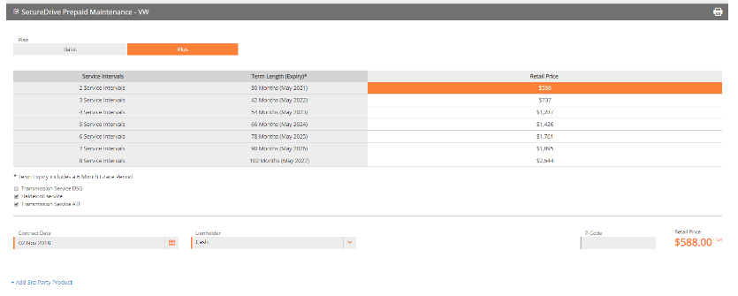
LGM HUB – Prepaid Maintenance
Click on the Prepaid Maintenance tab and complete the following steps:
Choose the amount of Service Intervals the customer is purchasing
2. Enter the Contract Date and Lienholder (if applicable)
To be replaced
You will now see the retail price of the product on the HUB screen.
Notes:
When you choose the “Prepaid Maintenance” tab, a drop down menu with product options will appear. To complete an Prepaid Maintenance sale, complete the following steps:
Choose the plan level and term in months
At the bottom of the menu, enter the contract date. If the customer is financing, you can also choose the lienholder from the drop down list.
Once you have completed this menu, you will see the retail price of the product on the bottom right of the screen.

Slide 33
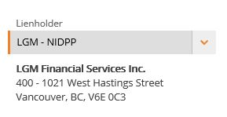
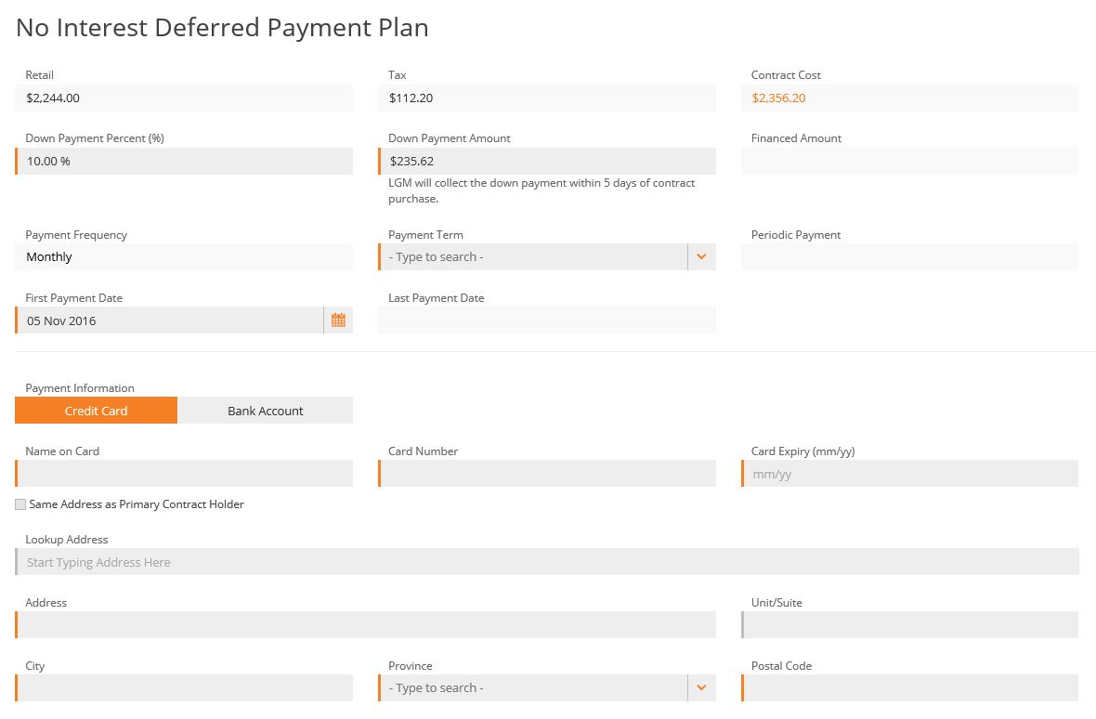
No Interest Deferred Payment Plan (NIDPP)
To choose the No Interest Deferred Payment Plan, complete the following steps.
Choose LGM-NIDPP as Lienholder
Enter the Down Payment and Payment Term
Enter Payment Information
Notes:
Eligible products can be financed with the No Interest Deferred Payment Plan, also known as NIDPP. Customers are pre-approved at 0% interest. The customer makes a minimum down payment of 10% of the product cost.
To finance with NIDPP, complete the following steps:
Choose LGM-NIDPP as the Lienholder from the drop down list.
Enter the down payment percent (this must be at least 10% of the cost of the product). Enter the payment term in months and the first payment date.
Finally, choose the method of payment (Credit Card or Bank Account) and payment information.
This payment plan generates a fee to the dealership of $20; it’s an administration fee and cannot be passed on to the customer. Although it’s an ideal payment option for cash customers that don’t have sufficient cash resources to purchase the product, it’s also ideal for those customers who bring in a bank draft for their new vehicle with the taxes and fees only. This is also a good option for those customers who decline to purchase the product at time of delivery and return after the sale.

Slide 34
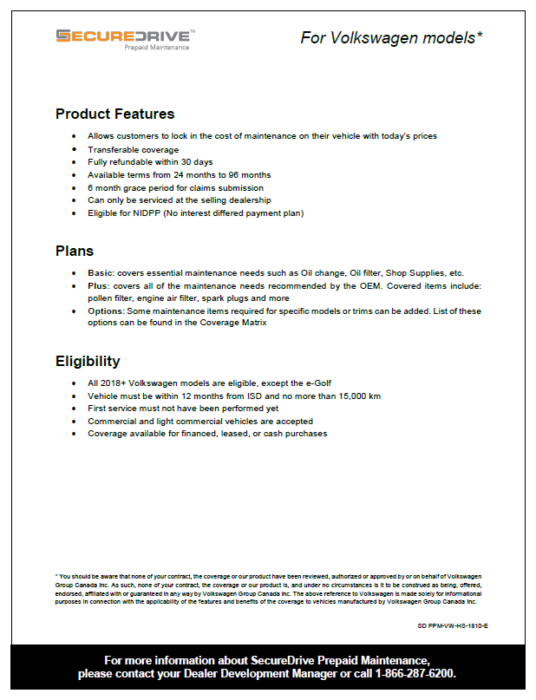
Sales Tools and Resources
Highlight Sheet
Selling Dealer Guide
Brochure

Slide 35
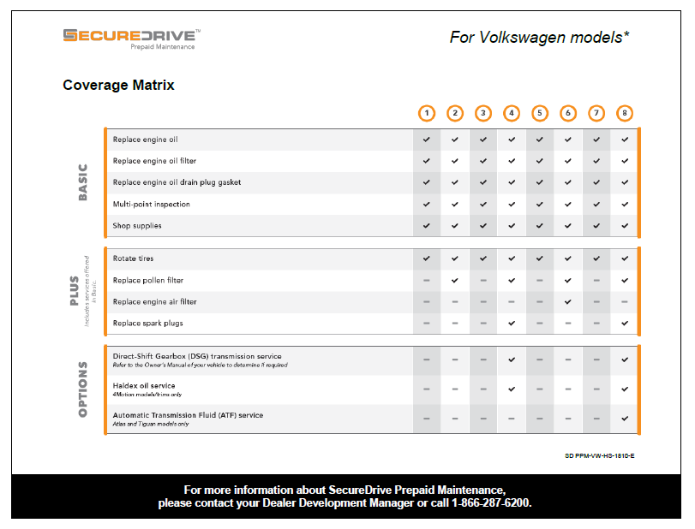
Sales Tools and Resources
Coverage Matrix

Slide 36
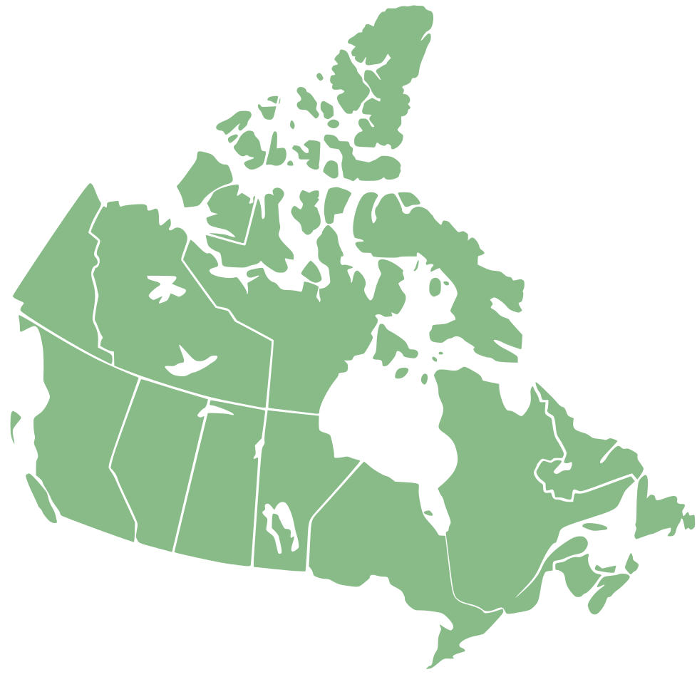
Resources for Ethical Sales
Canadian Auto Dealers Association (PEI and NL)
New Car Dealers Association of BC
Manitoba Motor Dealers Association
Nova Scotia Auto Dealers Association
Corporation des concessionnaires d’automobiles du Québec (CCAQ)
Saskatchewan Auto Dealers Association
New Brunswick Auto Dealers Association
Notes:
Notes:
-The following is a list of helpful resources that are related to ethical selling in Canada.
<click>
- The Corporation des concessionnaires d’automobiles du Québec (CCAQ) site is not available in English.
-The four images (BC, AB, ON, PQ) are councils that oversee auto and F&I sales in their respective province.
-All provinces have their respective councils or associations that they use to promote proper and ethical selling in the auto industry.
-Also, Advertising Standards Canada (ASC) governs proper advertising practices in the country (bait & switch, fine print, TV/radio/print, transparency)

Slide 37
About LGM
About LGM
LGM was established in 1998 and handles claims, administration, sales, support, training and marketing
We specialize in customizing OEM branded business office products
LGM Training consists of English and French Regional Trainers, with an in-house content development and coordination team.
Our state of the art offices and training facilities are located in Oakville, Montreal and Vancouver.
Our dedicated Dealer Development Managers and Sales VPs are on the road to manage dealer relationships

Slide 38
Questions?
Questions?
Questions?
Comments?

